Slide 1
Evaluation report of Russia's distributor network
1. Introduction of XXX(dealer name+city)
2. ХХХ business Plan
3. Comprehensive evaluation
GAC Motor Rus , Ltd.
XX.XX 2025
Background

Slide 2
XXX dealer
1. Introduction of “XXX ”
Applicant | XXX | Company business | Cars sales | Foundation | 1992
Registered capital | 10 000 000 RUB | Shareholder ratio | Petrov A.I. – 50% Nikitin A.A – 50%
Main business | Automobile industry
Current brands portfolio | Lada, Citroen, UAZ, Opel, Hyundai
Current showrooms situation | 10 showrooms in Moscow
General director | Ivanov Dmitry
Amount of employees | 560 employees
Company features | - Dealer is ready to invest in GAC and willing to cooperate - Professionalism and attentiveness of employees; convenient location - Good investment base for development and promotion of GAC brand on the local region - Dealer ready to renovate showroom in accordance with GAC standards Dealer ready to achieve high goals in sales and aftersales area High management skills, which help to promote brand included in the TOP-500 largest companies in Russia according to RBC

Slide 3
XXX dealer
1. Introduction of “XXX ”
XXX Auto sales records ( 2022 – 2024)
Brand | 2022 | 2023 | 2024
LADA | 9429 | 12791 | 6795
UAZ | 312 | 352 | 440
Hyundai | 1284 | 1526 | 524
Citroen | 263 | 430 | 185
Chery, since November 2020 | 22 | 484 | 842
FAW, since Nov 2022г. | - | - | 50
OMODA, since December 2022г. | - | - | 28
Пожалуйста укажите здесь объемы продаж по каждому бренду

Slide 4
XXX dealer
2. Business plan of XXX -Brands around and detailed information
Location detailed information
GPS Position and other brands nearby
Address | XXX
Dimension of GAC Showroom with reception | XXX sq.m.
Dimension of GAC Service center | XXX sq.m.
Brands nearby | XXXX
Land property (self-owned/rental) | XXX
Newly built/renovate | XX
Evaluation of the location | Good location with easy access to high customer traffic (MKAD, Crocus City Mall & Expo, wealthy living area)
Пожалуйста укажите дистанцию до ближайшего ДЦ GAC

Slide 5
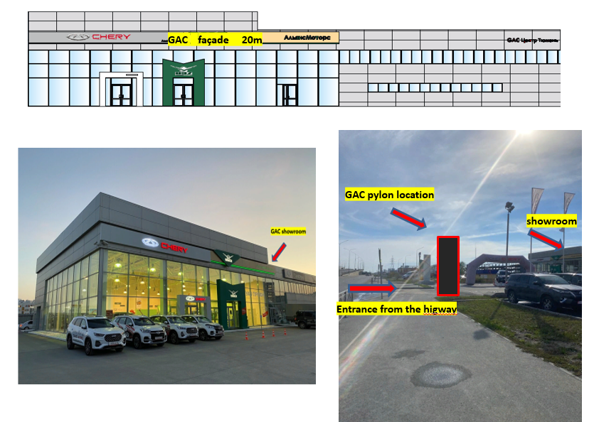
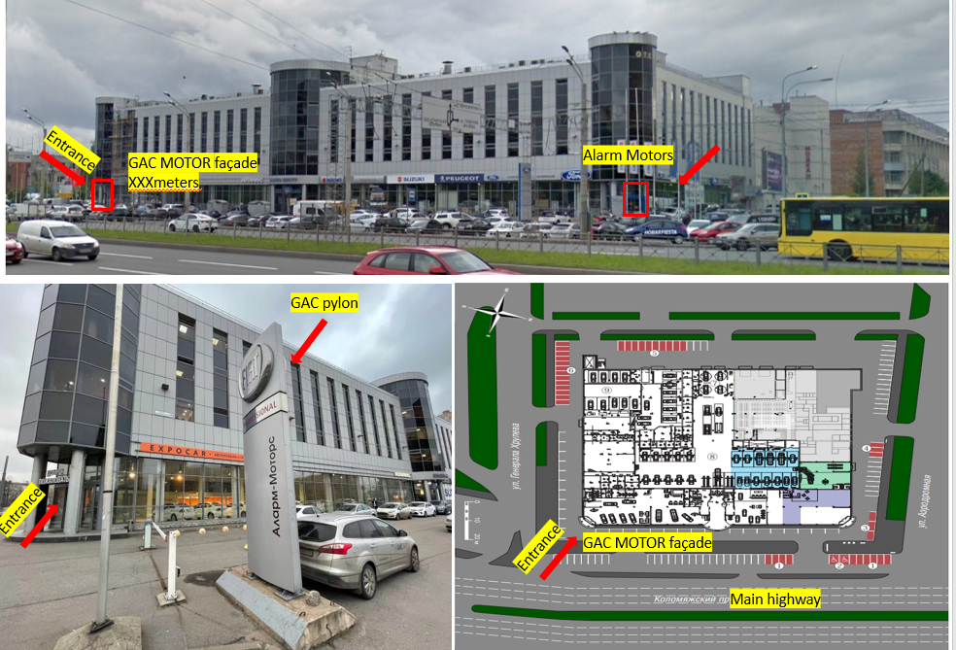
XXX dealer
2. Business Plan of XXX - GAC proposal outside view
2:
1:
Пожалуйста прикрепите фото,
дающие наглядное представление о расположении ДЦ,
его близлежащем окружении и
соседских брендах

Slide 6
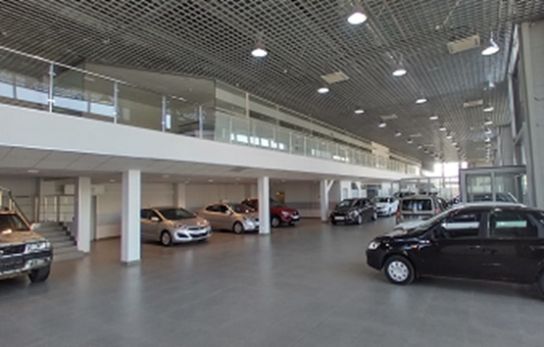
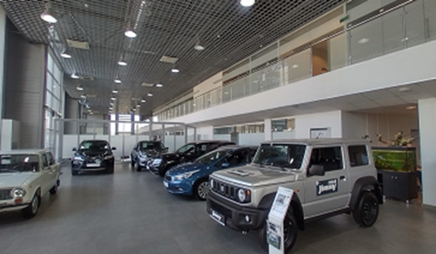
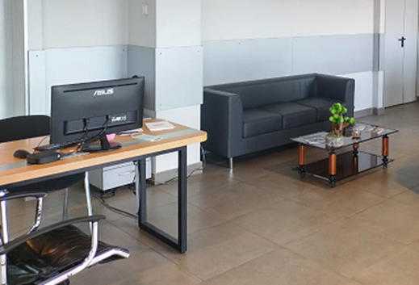
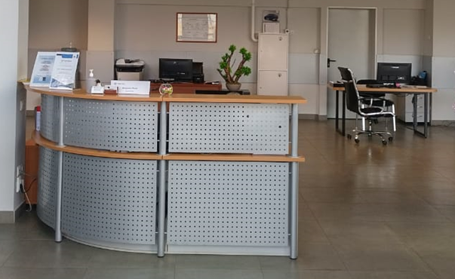
XXX dealer
2. Business Plan. GAC proposal Interior view
Showroom general information
Area- 700 sq.m. Car demonstration zones – 9 Reception-1 …..

Slide 7
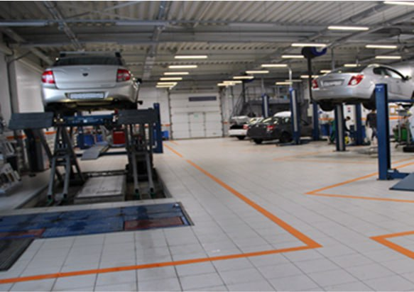
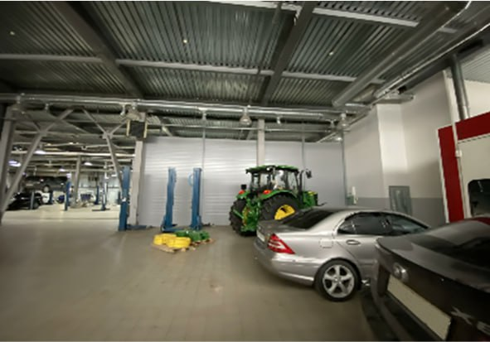
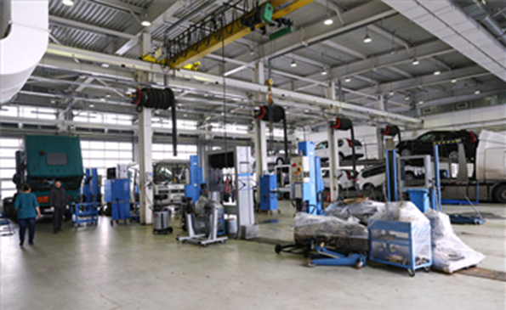
XXX dealer
2. Business Plan. GAC proposal Service Station
Service center general information
Area- 700 sq.m. Lifts-7 Diagnostic stations-1 Wheel alignment stations-1 Washing area-1 Spare parts warehouse - 1

Slide 8
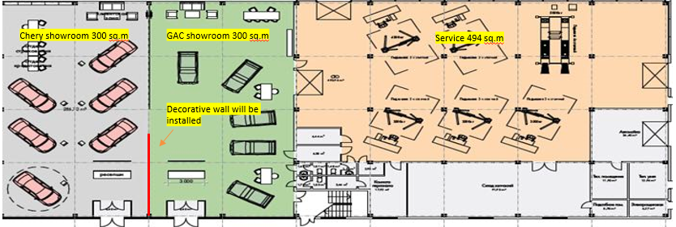
XXX dealer evaluation
GAC location layout
Пожалуйста приложите план здания

Slide 9
XXX dealer
2. Business Plan -Organizational chart for GAC brand
GAC Brand
General Manager
Name | XX
Education | XX
Experience | Over 20 years in Auto business 1. 06.03.2003-07.04.2005 XX head of corporate sales department 2. 20.09.2005-08.10.2008 Head of business development 2. XXX 4. XXXX
GAC employers | - 5 sales manager - 1 marketing manager (shared) - 1 reception 3 aftersales-managers 4 Service specialsits 2 credit managers Total: 16
Owner
General Manager (More than 20 years of experience)
Sales Director (13 years)
After-sales Director (More than 30 years of experience)
Marketing Director (14 years)
Managers (7-10 years)
Managers (7-8 years)
Managers (7 years)

Slide 10
XXX dealer evaluation
Shipment plan
2025 year plan
 | Jan | Feb | Mar | Apr | May | Jun | Jul | Aug | Sept | Oct | Nov | Dec | Total
GS8 | 25 | 25 | 25 | 25 | 25 | 25 | 25 | 25 | 25 | 25 | 25 | 25 | 300
M8 | 25 | 25 | 25 | 25 | 25 | 25 | 25 | 25 | 25 | 25 | 25 | 25 | 300
GS3 | 25 | 25 | 25 | 25 | 25 | 25 | 25 | 25 | 25 | 25 | 25 | 25 | 300
GS4 | 25 | 25 | 25 | 25 | 25 | 25 | 25 | 25 | 25 | 25 | 25 | 25 | 300
Empow | 25 | 25 | 25 | 25 | 25 | 25 | 25 | 25 | 25 | 25 | 25 | 25 | 300
Total | 125 | 125 | 125 | 125 | 125 | 125 | 125 | 125 | 125 | 125 | 125 | 125 | 1500
2025-2028 year plan
Model | 2025 | 2026 | 2027 | 2028
GS8 | 300 | 300 | 300 | 300
M8 | 300 | 300 | 300 | 300
GS3 | 300 | 300 | 300 | 300
GS4 | 300 | 300 | 300 | 300
Empow | 300 | 300 | 300 | 300
New models | 300 | 300 | 300 | 300
Total | 1500 | 1500 | 1500 | 1500

Slide 11
XXX dealer
3. Comprehensive Evaluation
Company name | XXX
Main business | Sales of new cars, used cars, spare parts; maintenance
Main passenger car brands | Lada, Chery, Omoda, FAW, Citroen, UAZ, Opel, Hyundai
Condition of existing area | Dealership area –1200m2 , renovated. Location – many brands are nearby. Location on MKAD, nearby two big Trade Malls – Mega and Sadovod
Financial status | Dealer uses only own funds to invest. Strong contribution potential to increase sales year by year in Moscow
Operating conditions | 2022 –11 310 units 2023 - 15 583units 2024 - 8 864 units
Order planning | 1st year (2025) – 1500 units. Ready to purchase 100 units from the start.
Investment plan | Dealer is ready to contribute in accordance with the plan + renovation expenses
Store plan | GAC showroom area – 700 m2, Service Area for GAC is 700 m2
Team plan | There are 560 employees . 16 of them will become the part of GAC brand
Overview | Dealer with good location on MKAD. Ready to invest and develop brand in Moscow region. Ready to purchase cars and start renovation ASAP
Suggestions | Moscow dealer TOP-500 company in Russia Big experience in sales (since 1992) Oldest dealer in Moscow. Location with high traffic (MKAD). Two big Trade Malls are near the dealership.

Slide 12
Пожалуйста укажите контактные данные:
название компании,
имя контактного лица, номер телефона,
адрес электронной почты

