Slide 1
Evaluation report of Russia's distributor network
1. Introduction of XXX(dealer name+city)
2. xxx business Plan
3. Comprehensive evaluation
GAC Motor Rus , Ltd.
XX.XX 2023
Background

Slide 2
XXX dealer evaluation
1. Introduction of “XXX ”
Applicant | XXX | Company business | Automobile trade | Foundation | 1992
Registered capital | 10 000 000 (RUB) | Shareholder ratio | Rogozhkin A.I. – 50% Solodushenkov A.A – 50%
Main business | Automobile industry
Current brands portfolio | Lada, Chery, Omoda, FAW, Citroen, UAZ, Opel, Hyundai
Current showrooms situation | 10 showrooms in Moscow
General director | Bogdanov Dmitry
Amount of employees | 560 employees
Company features | - Dealer is ready to invest in GAC and has very strong desire to cooperate. - Professionalism and attentiveness of employees; convenient location; high quality of service - Good investment base for development and promotion of GAC brand on the local region - Dealer ready to renovate showroom in accordance with GAC standarts Dealer ready to achieve high goals in sales and aftersales area High management skills, which help to promote brand included in the TOP-500 largest companies in Russia according to RBC

Slide 3
XXX dealer evaluation
1. Introduction of “XXX ”
XXX Auto sales records ( 2020 – 2022)
Brand | 2020 | 2021 | 2022
LADA | 9429 | 12791 | 6795
UAZ | 312 | 352 | 440
Hyundai | 1284 | 1526 | 524
Citroen | 263 | 430 | 185
Chery, since November 2020 | 22 | 484 | 842
FAW, since Nov 2022г. | - | - | 50
OMODA, since December 2022г. | - | - | 28
Pls note to indicate Chinese brand sales volume if this dealer cooperate with some Chinese brands

Slide 4
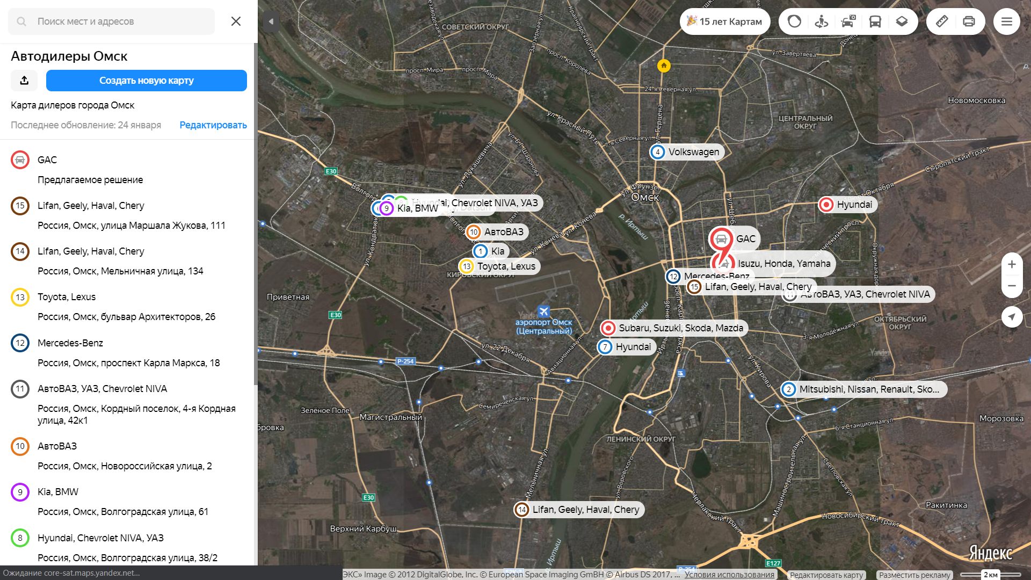
XXX dealer evaluation
2. Business plan of XXX -Brands around and detailed information
Location detailed information
GPS Position and other brands nearby
Address | XXX
Dimension of GAC Showroom with reception | XXX sq.m.
Dimension of GAC Service center | XXX sq.m.
Brands nearby | XXXX
Land property (self-owned/rental) | XXX
Newly built/renovate | XX
Evaluation of the location | Good location with easy access to high customer traffic (MKAD, Crocus City Mall & Expo, wealthy living area)
Please indicate the distance to existing GAC dealer outlets

Slide 5
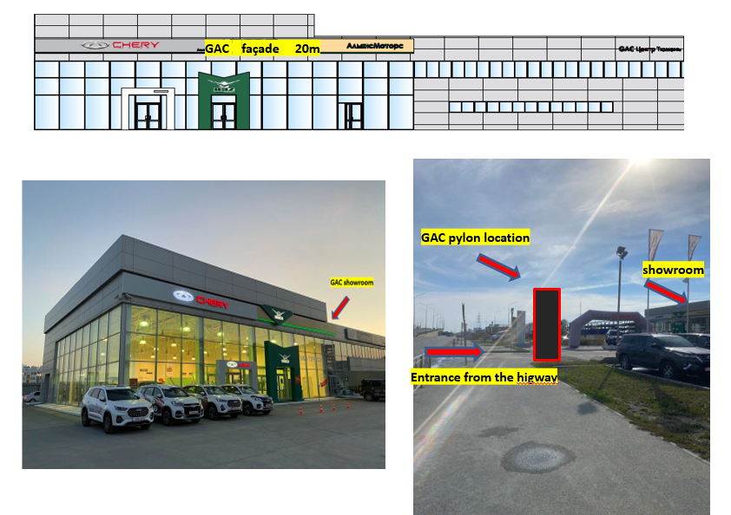
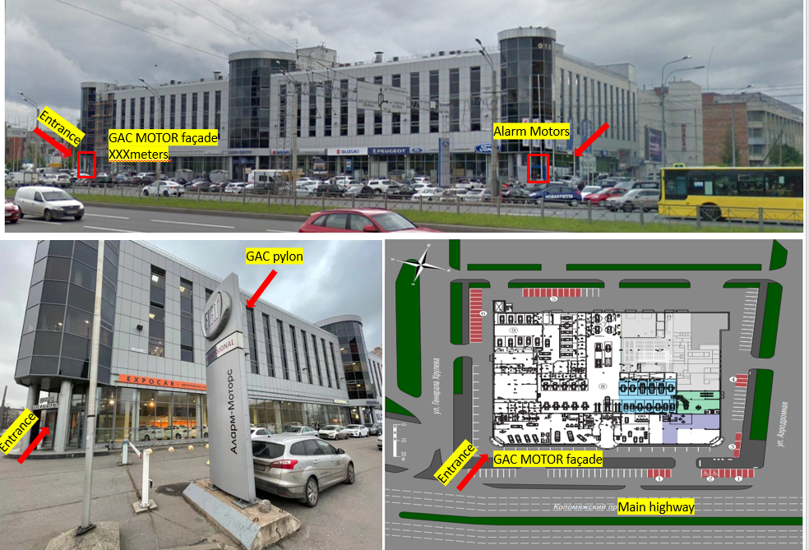
XXX dealer evaluation
2. Business Plan of XXX - GAC proposal outside view
2:
1:
These are 2 examples
The point is :
Show outside overall situation
Show this whole building(to see which brand will be together with GAC), and indicate intrance+façade length+Pylon

Slide 6
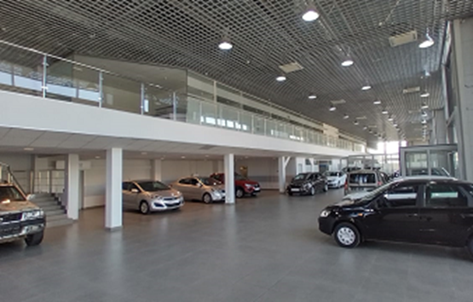
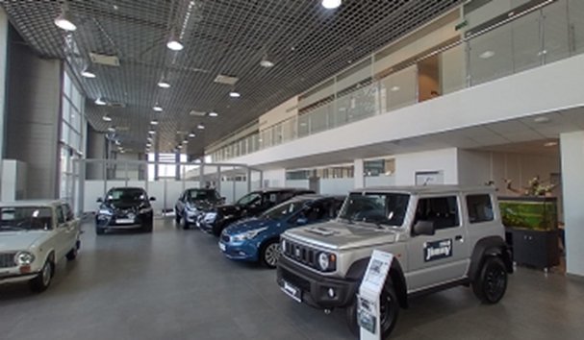
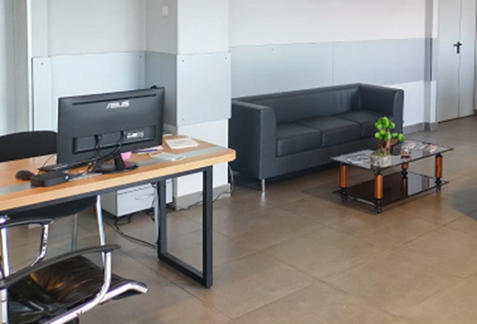
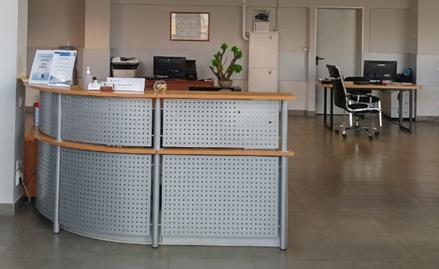
XXX dealer evaluation
2. Business Plan. GAC proposal Interior view
Showroom general information
Area- 490 sq.m. Car demonstration zones – 6 Reception-1 XXX

Slide 7
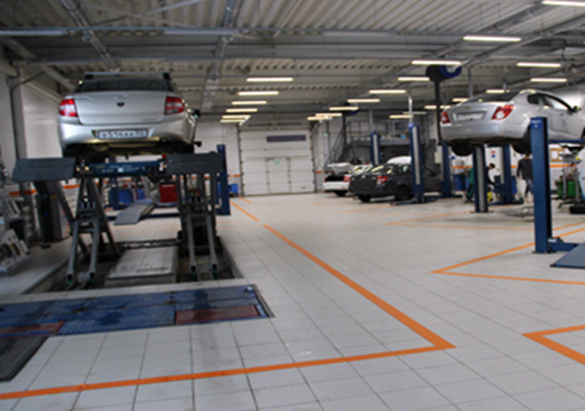
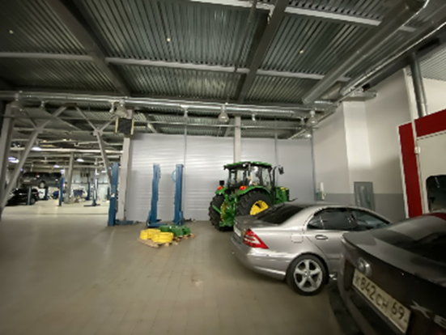
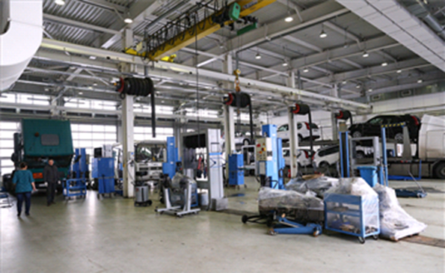
XXX dealer evaluation
2. Business Plan. GAC proposal Service Station
Service center general information
Area- 480 sq.m. Lifts-4 Diagnostic stations-1 Wheel alignment stations-1 Washing area-1 Spare parts warehouse - 1

Slide 8
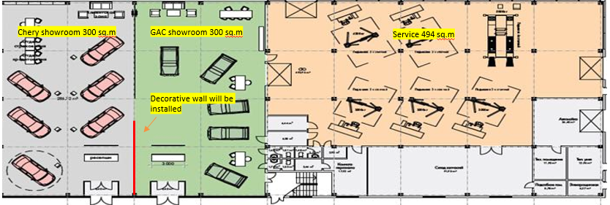
XXX dealer evaluation
GAC location layout
Here to show Showroom+Service layout

Slide 9
XXX dealer evaluation
2. Business Plan -Organizational chart for GAC brand
GAC Brand
General Manager
Name | XX
Education | XX
Experience | Over 20 years in Auto business 1. 06.03.2003-07.04.2005 XX head of department for work with corporate clients; 2. 20.09.2005-08.10.2008 Severstal- Auto" Head of Department corporate sales 2. XXX 4. XXXX
GAC employers | - 5 sales manager - 1 marketing manager (shared) - 1 reception 3 aftersales-managers 4 Service specialsits 2 credit managers Total: 16
Owner
General Manager (More than 20 years of experience)
Sales Director (13 years)
After-sales Director (More than 30 years of experience)
Marketing Director (14 years)
Managers (7-10 years)
Managers (7-8 years)
Managers (7 years)

Slide 10
XXX dealer evaluation
Shipment plan
2024 year plan
 | Jan | Feb | Mar | Apr | May | Jun | Jul | Aug | Sept | Oct | Nov | Dec | Total
GS8 | 10 | 10 | 10 | 10 | 12 | 14 | 15 | 13 | 15 | 15 | 14 | 26
M8 |  |  | 5 | 5 | 5 | 5 | 6 | 6 | 6 | 6 | 5 | 10
GS3 |  |  |  | 8 | 8 | 8 | 8 | 7 | 9 | 9 | 8 | 14
EMKOO |  |  |  |  |  |  |  |  | 10 | 10 | 10 | 10
Total
2024-2027 year plan
Model | 2024 | 2025 | 2026 | 2027 | Total
GS8 | 170 | 200 | 240 | 270
M8 | 65 | 85 | 80 | 95
GS3 | 85 | 100 | 120 | 140
EMKOO | 200 | 300 | 400 | 500
New models
Total

Slide 11
XXX dealer evaluation
3. Comprehensive Evaluation
Company name | XXX
Main business | Sales of new cars, used cars, spare parts; maintenance
Main passenger car brands | Lada, Chery, Omoda, FAW, Citroen, UAZ, Opel, Hyundai
Condition of existing area | Dealership area –1200m2 , renovated. Location – many brands are nearby. Location on MKAD, nearby two big Trade Malls – Mega and Sadovod
Financial status | Dealer uses only own funds to invest. Strong contribution potential to increase sales year by year in Moscow
Operating conditions | 2020 –11 310 units 2021 - 15 583units 2022 - 8 864 units
Order planning | 1st year (2022) – 244 units. Ready to purchase 10 – 15 units from the start.
Investment plan | Dealer is ready to contribute in accordance with the plan + renovation expenses
Store plan | GAC showroom area – 400 m2, Service Area for GAC is 495 m2
Team plan | There are 560 employees . 16 of them will become the part of GAC brand.
Overview | Dealer with good location on MKAD. Ready to invest and develop brand in Moscow region. Ready to purchase cars and start renovation ASAP.
Suggestions | Moscow dealer TOP-500 company in Russia Big experience in sales (since 1992) Oldest dealer in Moscow. Location with high traffic (MKAD). Two big Trade Malls are near the dealership.

Slide 12

Please fill in contact details here: Company name, contact person name, phone, email

